Slide 2
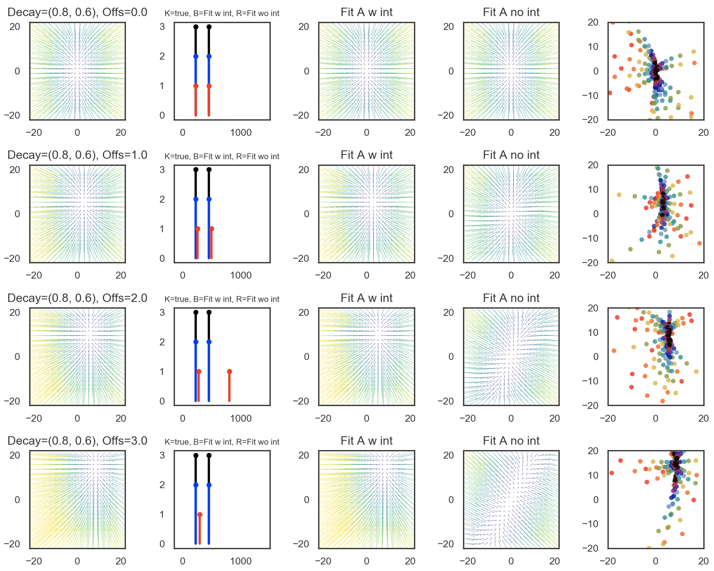
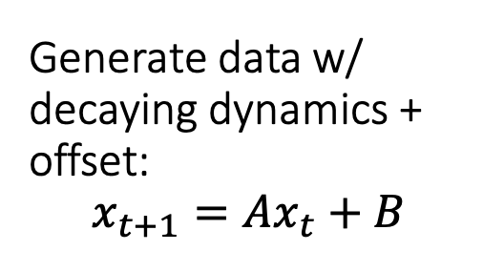
Generate data w/ decaying dynamics + offset: $$x_{t+1}=Ax_{t}+B$$
See how fitting with a model without an offset affects data;
Can fitting without offset on mean subtracted data work?

Slide 3
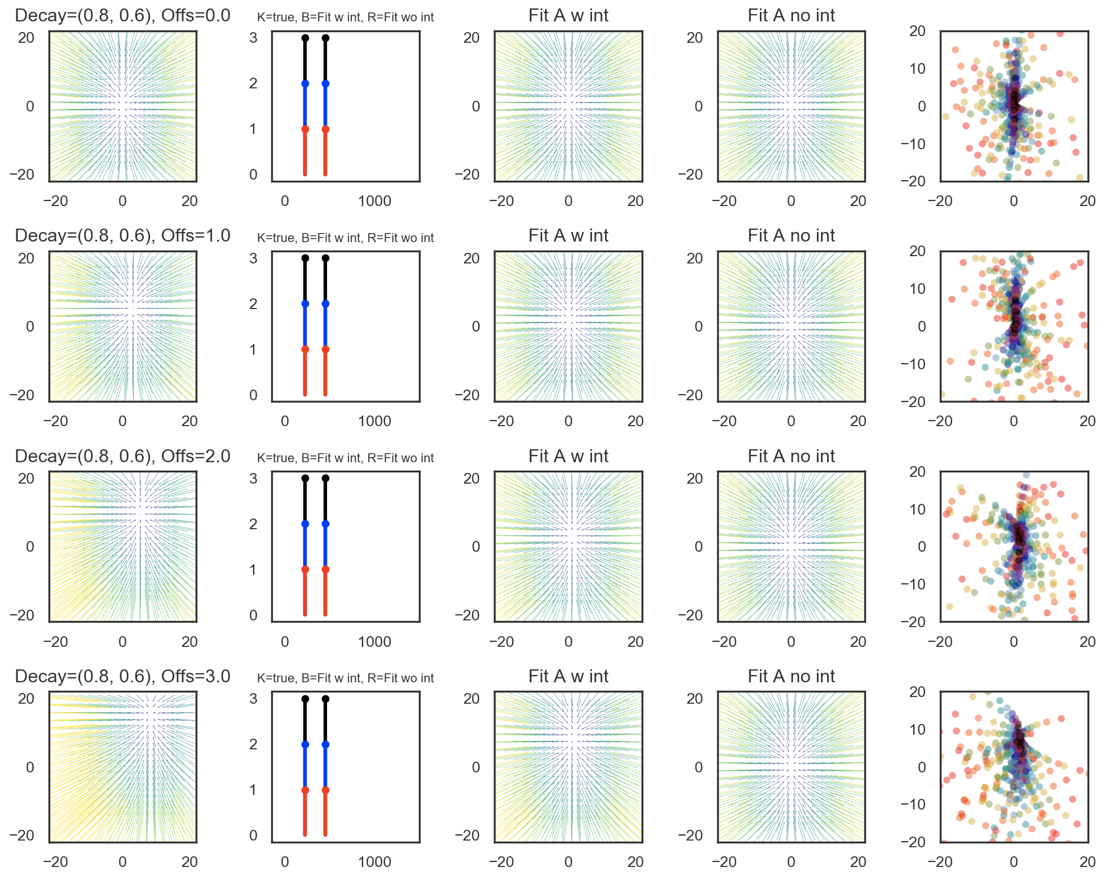
With mean subtraction on the data before fitting; Mean is biased since not centered around stable pt;
Still not perfect – intercept still captures some offset that seems to be data-present but does better;

Slide 4
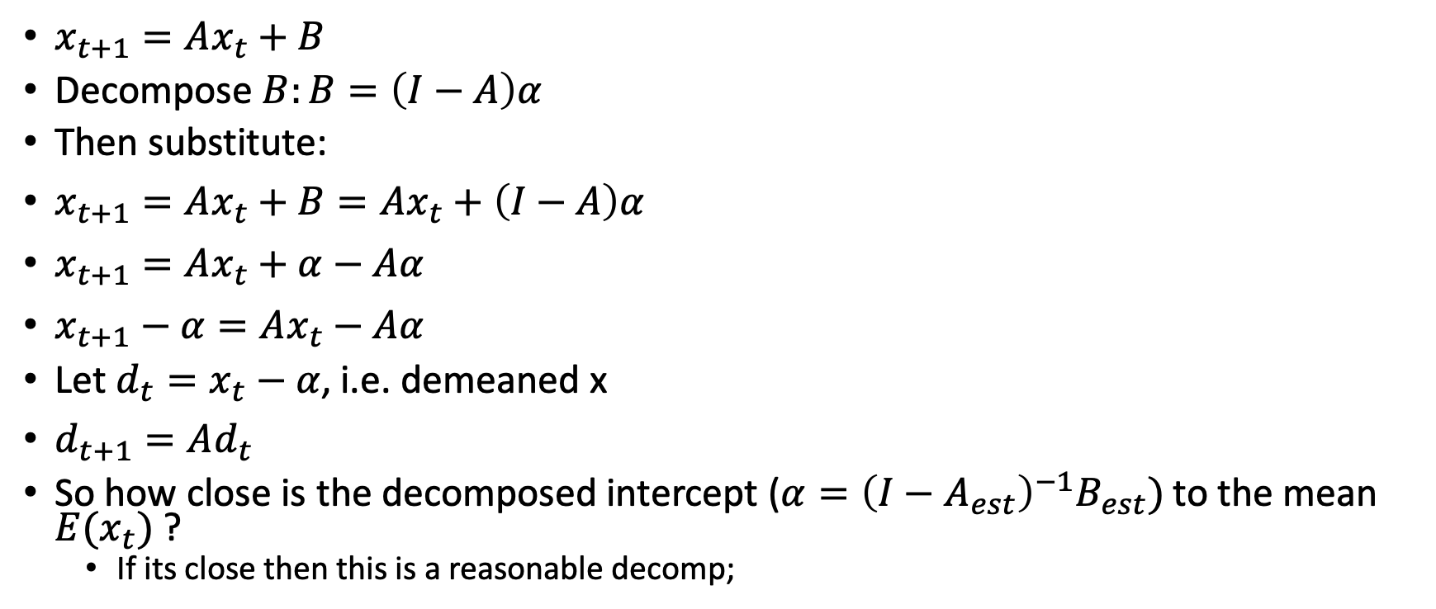
Is fitting with an intercept the same as fitting on mean subtracted data?
$x_{t+1}=Ax_{t}+B$
Decompose $B:B=\left(I−A\right)α$
Then substitute:
$x_{t+1}=Ax_{t}+B=Ax_{t}+\left(I−A\right)α$
$x_{t+1}=Ax_{t}+α−Aα$
$x_{t+1}−α=Ax_{t}−Aα$
Let $d_{t}=x_{t}−α$, i.e. demeaned x
$d_{t+1}=Ad_{t}$
So how close is the decomposed intercept ($α={\left(I−A_{est}\right)}^{−1}B_{est})$to the mean $E(x_{t})$ ?
If its close then this is a reasonable decomp;

Slide 5
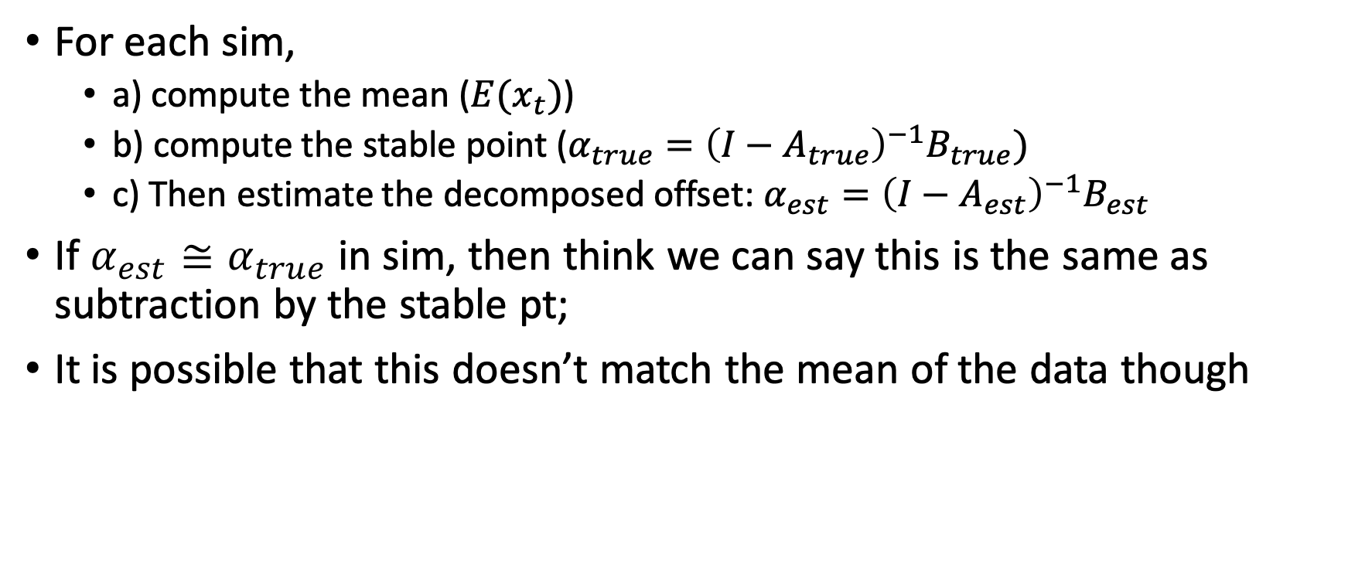
For each sim, compute the stable point
For each sim,
a) compute the mean ($E(x_{t})$)
b) compute the stable point ($α_{true}={{\left(I−A_{true}\right)}^{−1}B}_{true})$
c) Then estimate the decomposed offset: $α_{est}={\left(I−A_{est}\right)}^{−1}B_{est}$
If $α_{est}≅α_{true}$ in sim, then think we can say this is the same as subtraction by the stable pt;
It is possible that this doesn’t match the mean of the data though

Slide 6
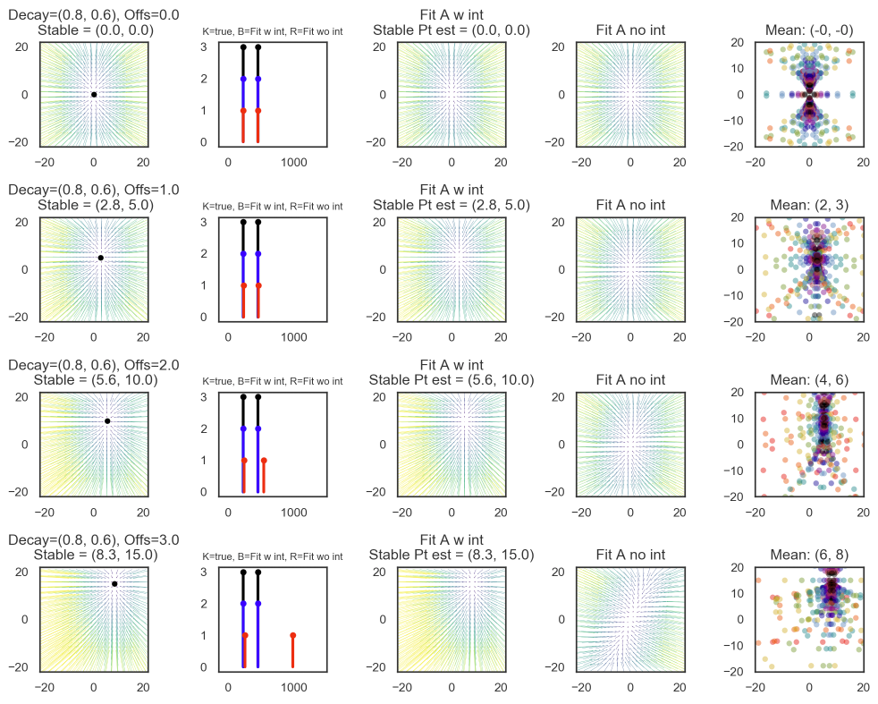
No mean subtraction
Can see that intercept estimates the stable pt perfectly
Mean doesn’t always match stable point, likely the reason that mean subtraction doesn’t always work to make stable pt = (0,0)

Slide 7
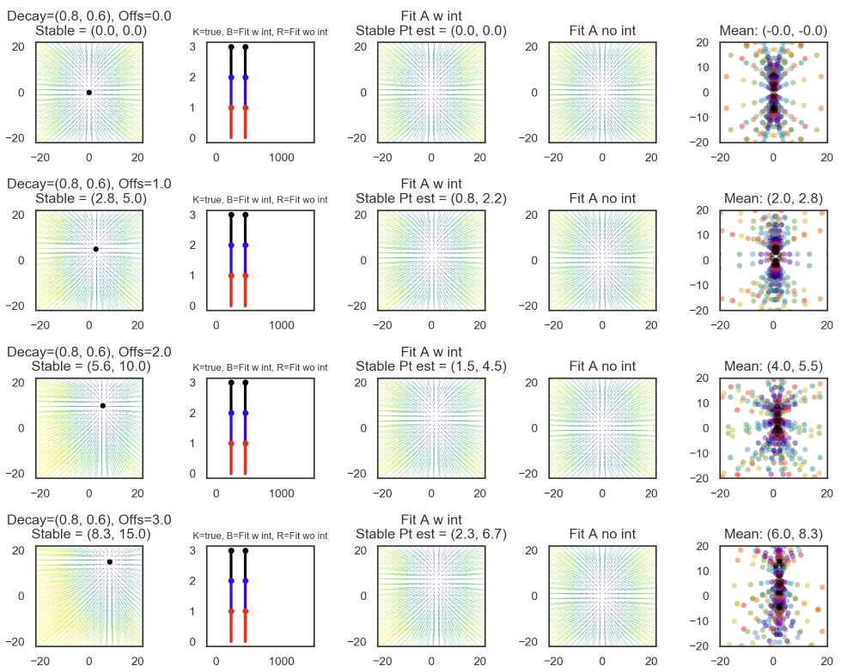
With mean subtraction
Can see that intercept estimates the stable pt that wasn’t able to be accounted for by mean subtraction
(8.3, 15.0) – (6, 8.3) = (2.3, 6.7) = stable pt of last graph fit;
Mean doesn’t always match stable point, due to distribution of data around the stable point

Slide 8
Conclusion;
Adding the offset in the model allows you to account for non-zero stable points (in decaying dynamics)
Fitting on demeaned data can yield accurate eigenvalues, works best if data is symmetrically distributed around the stable point
In our data, could estimate the “stable” point via dynamics model fit w/ intercept, and see how well it matches the mean
Not having an offset in the model prevents you from modeling dynamics correctly → wrong eigenvalues;

Slide 9
Our data, no ridge param
Days with tons of neurons in blue

Slide 10
Ridge, with intercept;
”Stable point” mostly seems to match the mean
So adding we may be in a situation where what look like long, decaying dynamics are really just estimates of a far away stable point

Slide 11
Eigenvalues with Ridge pls intercept:

Slide 12
Eigenvalues with Ridge, no intercept, on demeaned data :/

